Slide 1

Chapter 1:
Introduction
to
Computers
and
Programming

Slide 2
1.1
Why Program?

Slide 3
Why Program?
Computer – programmable machine designed to follow instructions
Program – instructions in computer memory to make it do something
Programmer – person who writes instructions (programs) to make computer perform a task
SO, without programmers, no programs; without programs, a computer cannot do anything

Slide 4
1.2
Computer Systems: Hardware and Software

Slide 5
Main Hardware Component Categories:
Central Processing Unit (CPU)
Main Memory
Secondary Memory / Storage
Input Devices
Output Devices

Slide 6
1.3
Programs and Programming Languages

Slide 7

Programs and Programming Languages
A program is a set of instructions that the computer follows to perform a task
We start with an algorithm, which is a set of well-defined steps.
What would be the algorithm for a program that gets two numbers from the user, adds them and displays the sum?

Slide 8
Algorithm
Write an algorithm to calculate and display the gross pay of a tutor? Gross pay is the product of the number of hours worked and hourly pay rate.

Slide 9
Example Algorithm for Calculating Gross Pay
Get the values for hours worked and hourly pay rate.
Multiply the two values to get the gross pay.
Display the gross pay.

Slide 10
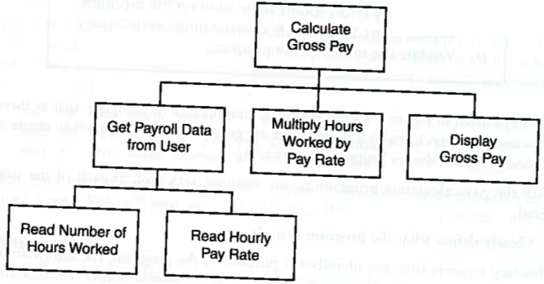
Hierarchy Chart for Calculating Gross Pay
A hierarchy chart begins with the overall task then refines it into smaller subtasks, until each is small enough to be easily performed.

Slide 11
Machine Language
Although the previous algorithm defines the steps for calculating the gross pay, it is not ready to be executed on the computer.
The computer only executes machine language instructions

Slide 12
Machine Language
Machine language instructions are binary numbers, such as
1011010000000101
Rather than writing programs in machine language, programmers use programming languages.

Slide 13
Some Well-Known Programming Languages
C++
BASIC
Ruby
Java
FORTRAN
Visual Basic
C#
COBOL
JavaScript
C
Python

Slide 14
C++ Program
Write a C++ program to calculate and display the gross pay of a tutor? Gross pay is the product of the number of hours worked and hourly pay rate.

Slide 15
C++ Program for Calculating Gross Pay
#include <iostream>
using namespace std;
int main()
{
  double rate = 15;
  double hours = 10.5;
  double pay = rate * hours;
  cout << pay;
  return 0;
}

Slide 16
Integrated Development Environments (IDEs)
An integrated development environment, or IDE, combine all the tools needed to write, compile, and debug a program into a single software application.
Examples are Microsoft Visual C++, Xcode, Eclipse, Netbeans, etc.

Slide 17
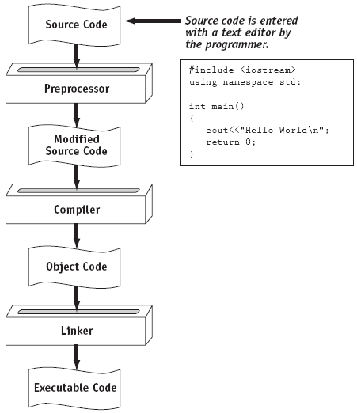
From a High-Level Program to an Executable File

Slide 18
1.4
What is a Program Made of?

Slide 19
What is a Program Made of?
Common elements in programming languages:
  Key Words
  Programmer-Defined Identifiers
  Operators
  Punctuation
  Syntax

Slide 20
C++ Program for Calculating Gross Pay
#include <iostream>
using namespace std;
int main()
{
  double rate = 15;
  double hours = 10.5;
  double pay = rate * hours;
  cout << pay;
  return 0;
}

Slide 21
Key Words
Also known as reserved words
Have a special meaning in C++
Can not be used for any other purpose
Key words in the previous program: using, namespace, double, and return

Slide 22
Programmer-Defined Identifiers
Names made up by the programmer
Not part of the C++ language
Used to represent various things: variables (memory locations), functions, etc.
In previous program : hours, rate, and pay.

Slide 23
Operators
Used to perform operations on data
Many types of operators:
  Arithmetic - ex: +,-,*,/
  Assignment – ex: =
Some operators in previous program :
<< = *

Slide 24
Punctuation
Characters that mark the end of a statement, or that separate items in a list
In previous program : ;

Slide 25
Syntax
The rules of grammar that must be followed when writing a program
Controls the use of key words, operators, programmer-defined symbols, and punctuation

Slide 26
Variables
A variable is a named storage location in the computer’s memory for holding a piece of data.
In the previous program, we used three variables:
  The hours variable was used to hold the hours worked
  The rate variable was used to hold the pay rate
  The pay variable was used to hold the gross pay

Slide 27
Variable Definitions
To create a variable in a program you must write a variable definition (also called a variable declaration)
Here is the statement from the previous program that defines the variables:
double hours, rate, pay;

Slide 28
1.5
Input, Processing, and Output

Slide 29
Input, Processing, and Output
Three steps that a program typically performs:
  Gather input data:
    from keyboard
    from files on disk drives
  Process the input data
  Display the results as output:
    send it to the screen
    write to a file

Slide 30
1.7
Procedural and Object-Oriented Programming

Slide 31
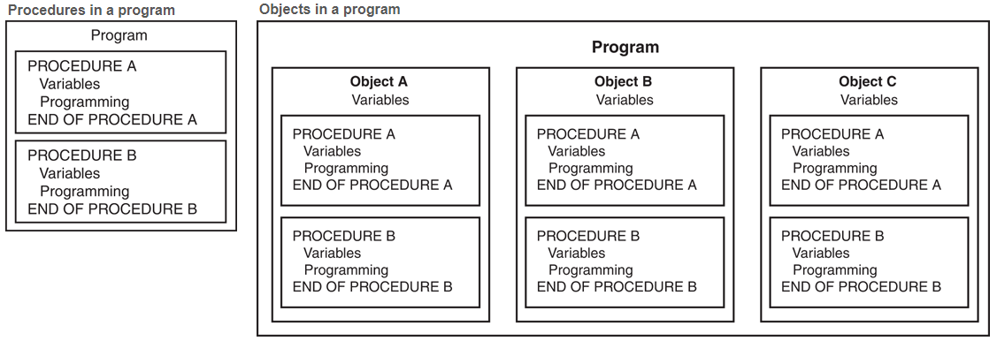
Procedural and Object-Oriented Programming
Procedural programming: centered on procedures (or functions, as they are called in C++). Functions are written to process data.
Object-Oriented programming: centered on objects, which contain data and the procedures that operate on the data.

